Slide 1


Computer vision
Encadré par: Besbes Olfa
Realisé par: Barketi Ahlem
Kalthoum Ibtihel
3 DNI 1
2022-2023

Slide 2

Partie 1
01
02
Partie 2
LAB2: END-TO-END MACHINE LEARNING PROJECT “FACE DETECTION APPLICATION”
LAB3: SKIN CANCER DETECTION WITH ANDROID APP

Slide 3


Face detection application

Slide 4

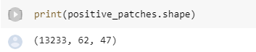
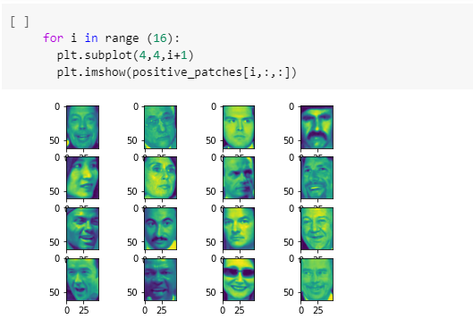
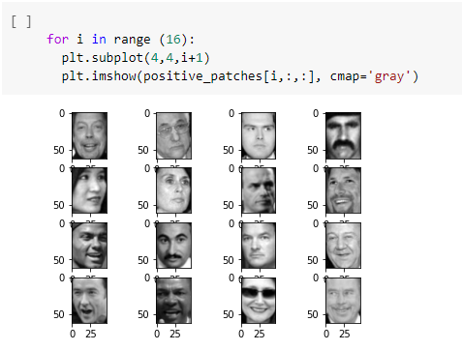
1. Feature Engineering
Show some positive samples(plt.subplot() and plt.imshow())

Slide 5
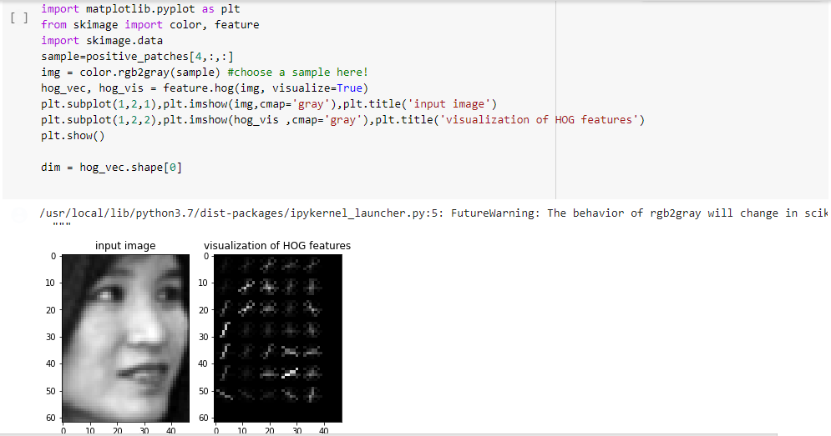
Try the Scikit-Image’s HOG extractor and visualize the oriented gradients

Slide 6
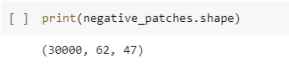
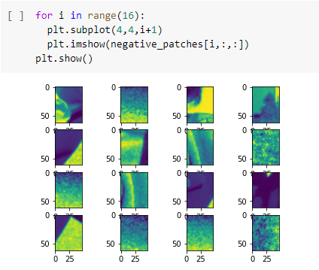
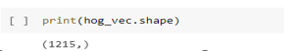
Number of negative samples in negative_patches
Show some negative sample(plt.subplot() and plt.imshow())

Slide 7
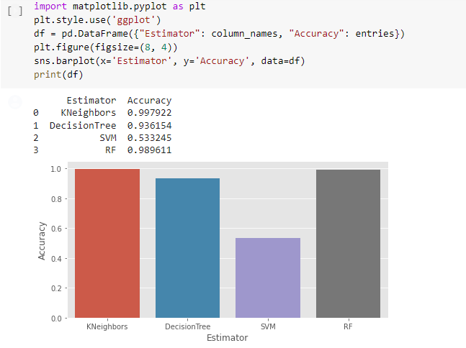
2. Binary Classification using Scikit-Learn

Slide 8
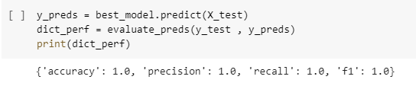
3. Evaluating the Best Face Detector
Afin d'optimiser les paramètres de chaque algorithme pour savoir lequel qui a la meilleure performance, on remarque que l'algorithme KNeighbors est le plus performant avec 0.997922 .

Slide 9
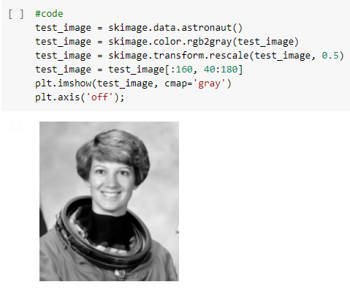
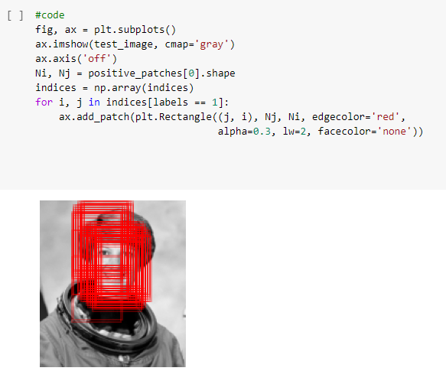
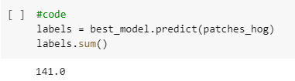
4. Finding Faces in a New Image
Draw face detected patches as rectangles:

Slide 10
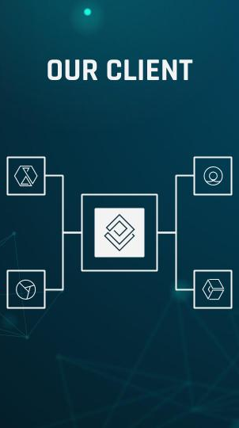
MOBILE APP
SKIN CANCER DETECTION WITH ANDROID APP

Slide 11
01
02
TensorFlow and Keras are used to build and create a machine learning model.
TFLite is used to deploy the model to an Android application.

Slide 12
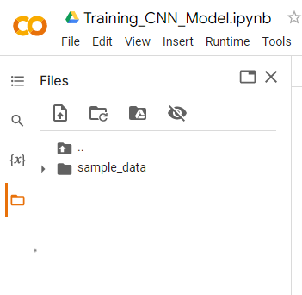
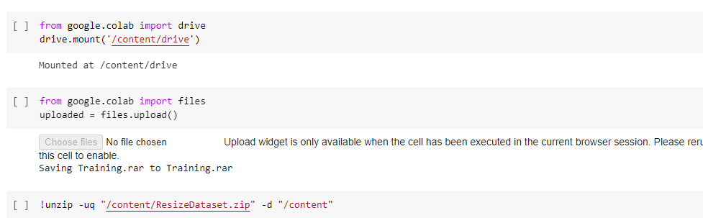
Loading the data:

Slide 13
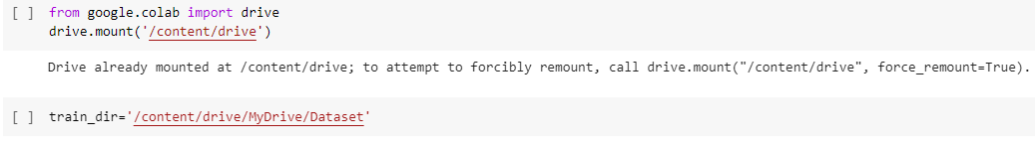

Slide 14
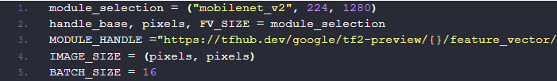
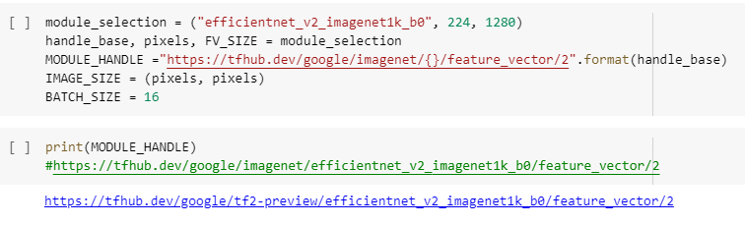
Transfer Learning with TensorFlow hub:

Slide 15
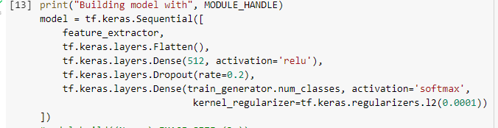
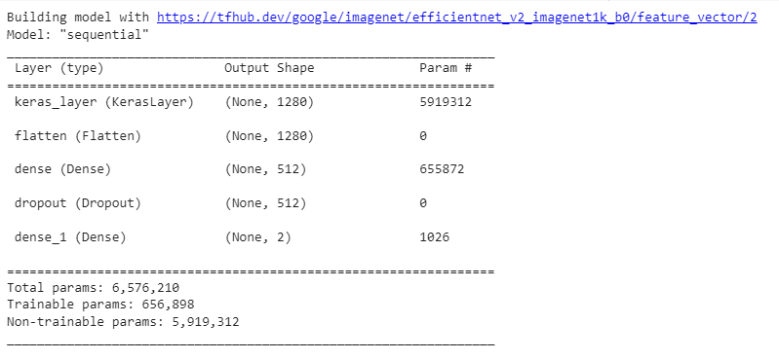
Build the model:

Slide 16
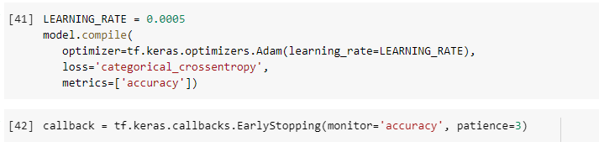
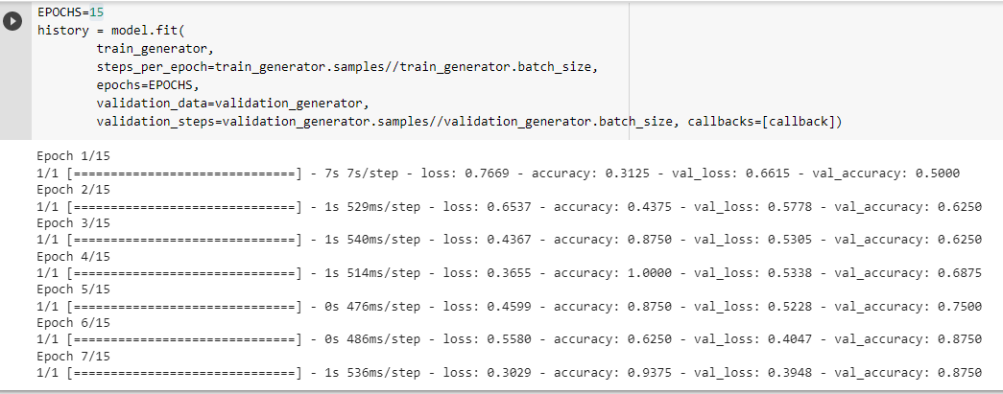
Training Model:

Slide 17
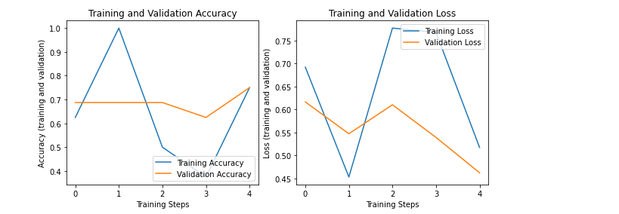
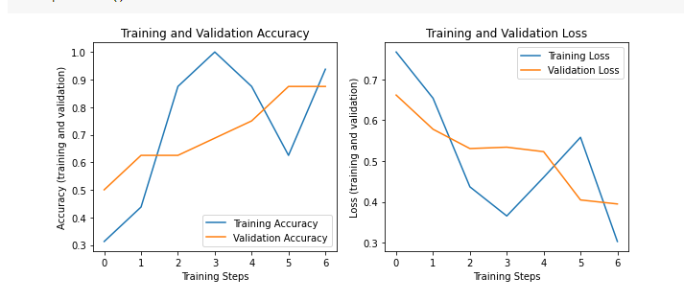
Checking Performance:

Slide 18
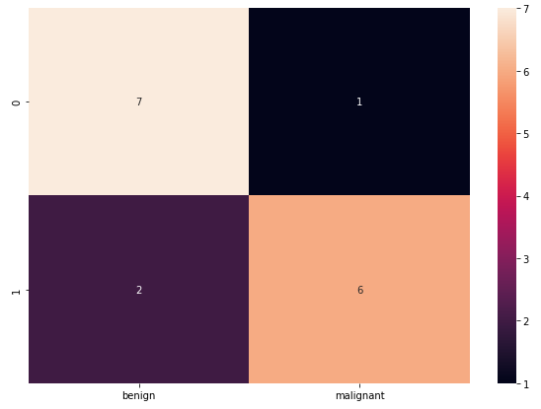
Confusion Matrix
La matrice de confusion est un outil de mesure de la performance des modèles de classification

Slide 19

TFLite is used to deploy the model to an Android application.

Slide 20
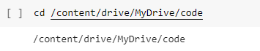
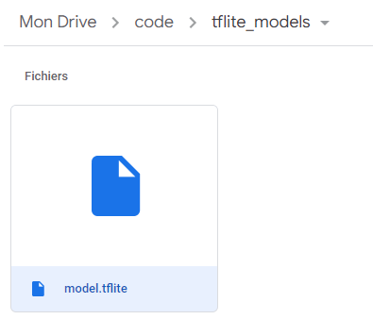
Export as saved model and convert to TFLite

Slide 21
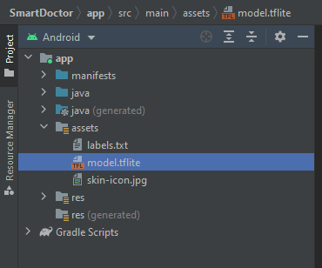
Android App

Slide 22
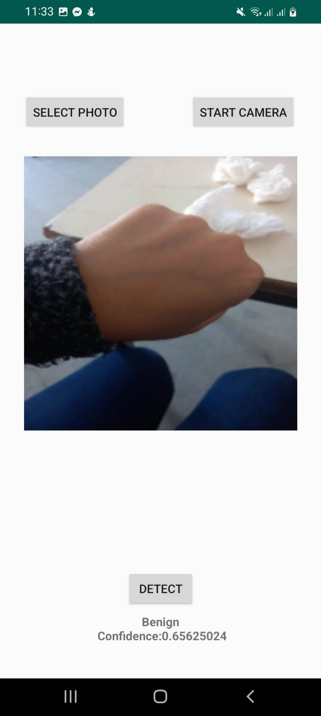
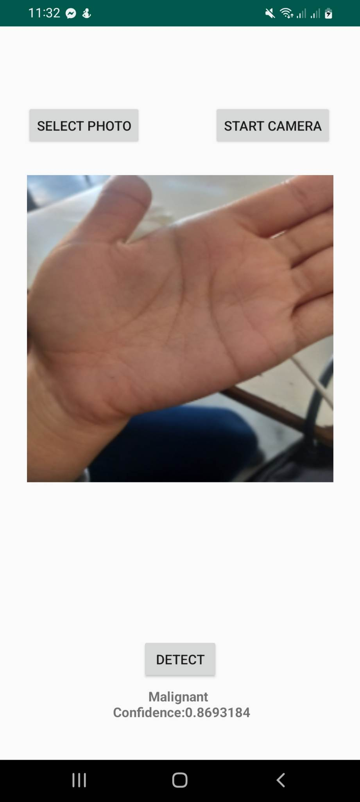

Slide 23
THANKS for your attention !

